Slide 1
A few significant places and events in Bjarne’s life

Slide 2
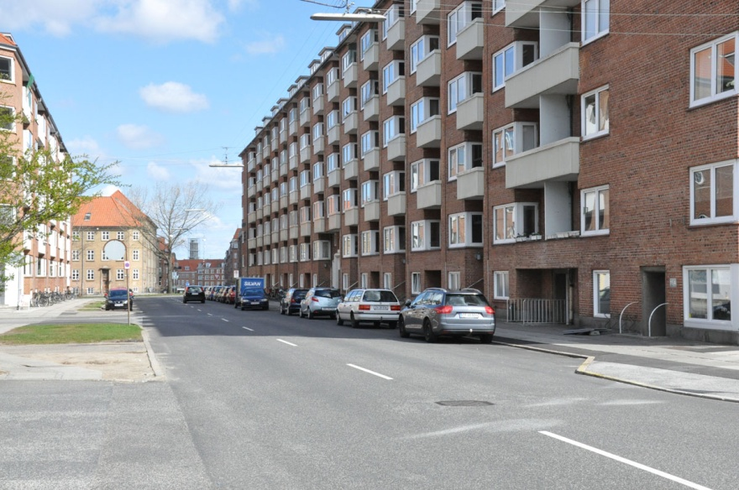
Bjarne lived here the first 23 years

Slide 3
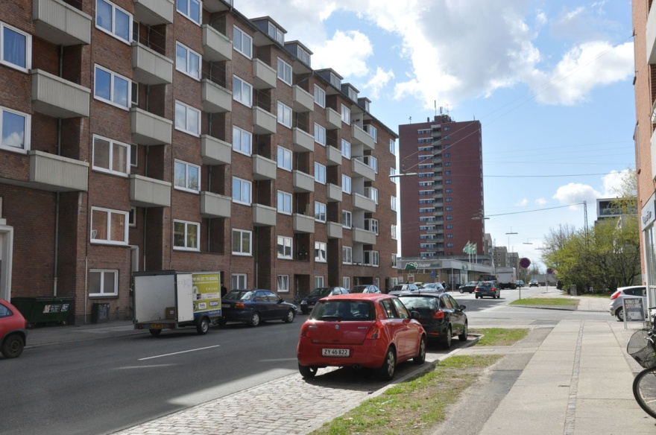
Bjarne lived here the first 23 years

Slide 4
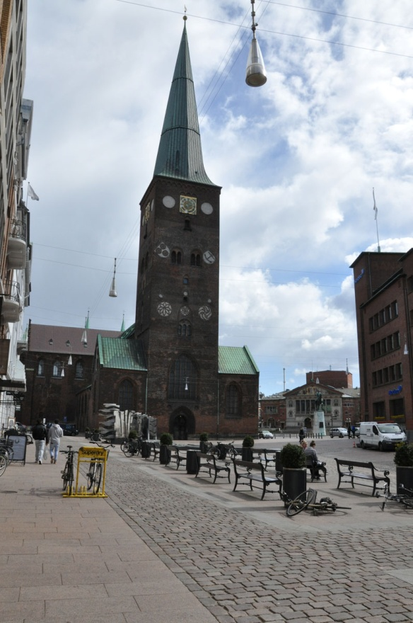
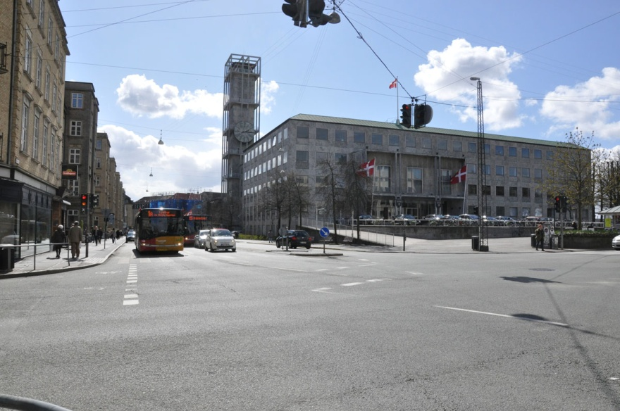
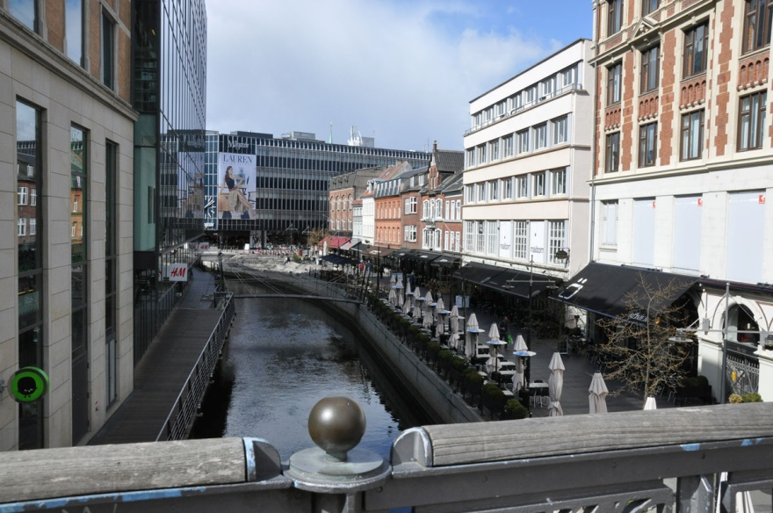
The city Aarhus, Denmark

Slide 5
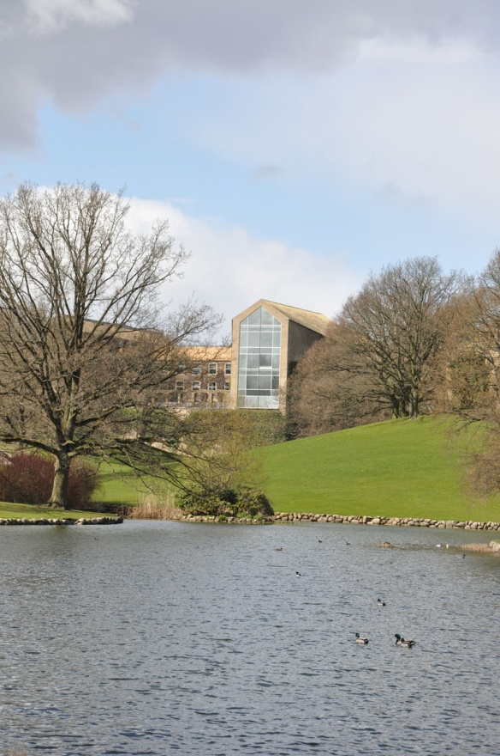
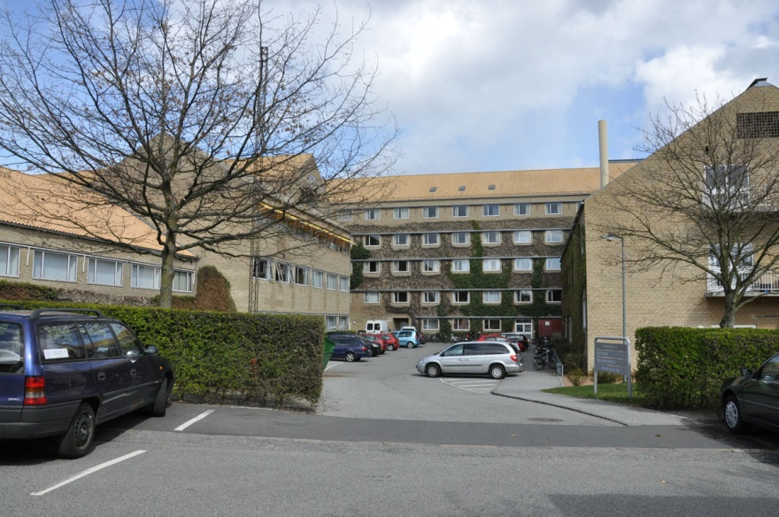
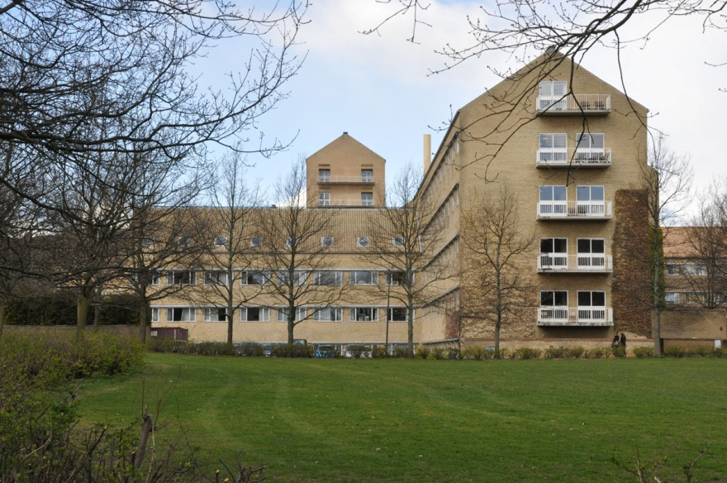
University of Aarhus – Bjarne’s University

Slide 6
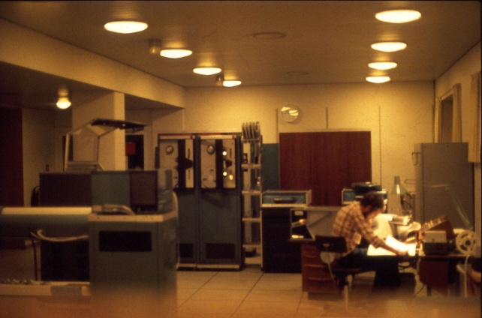
First computer Bjarne used
RAM:
5+20kBytes
Clock:
0,5 MHz
Harddisk:
10Mbytes
Language:
Algol60

Slide 7
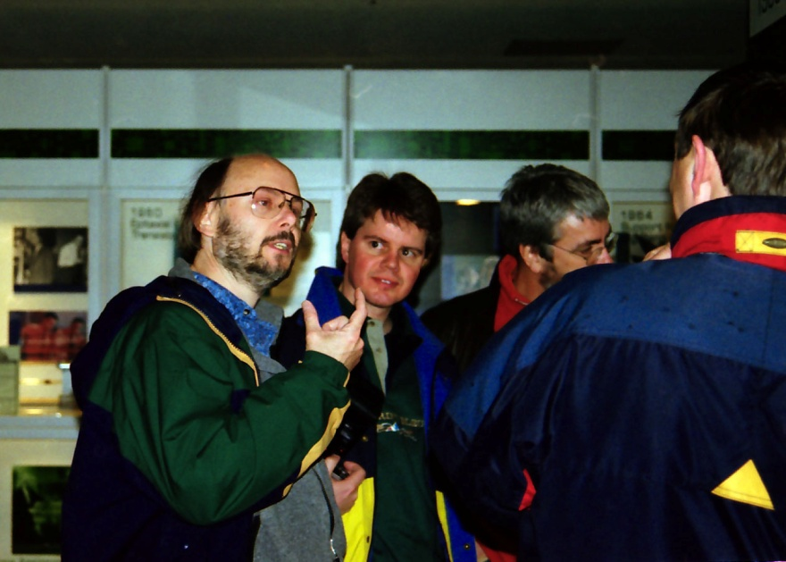
Visitors from Denmark at Bell’s Lab 1998

Slide 8
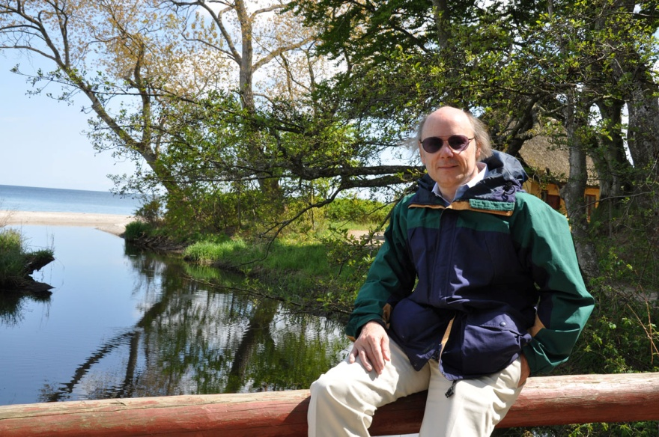
Relaxing in Aarhus the day before receiving the Danish science prize

Slide 9
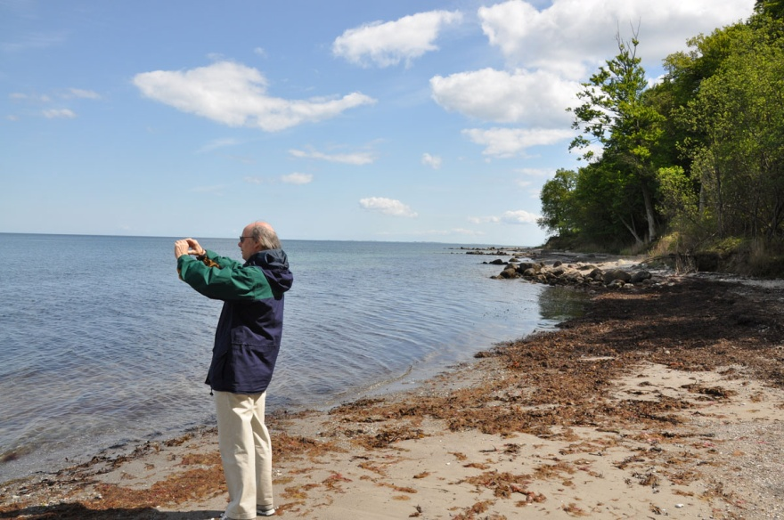
The beach and wood south of Aarhus

Slide 10
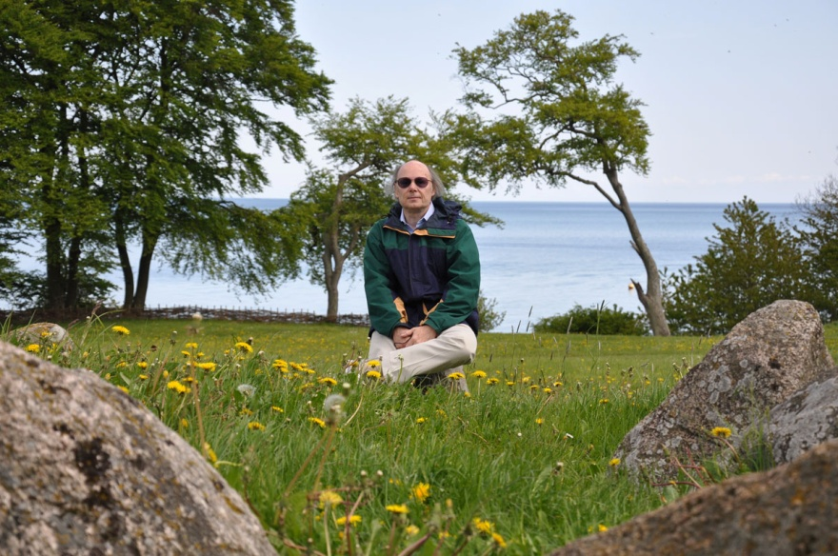

Slide 11
Aarhus University awards Bjarne Stroustrup the famous Rigmor and Carl Holst-Knudsen Science Prize on Friday May 28:
Bjarne Stroustrup is the designer of the programming language C++ and has had a significant and an essential influence on the object-oriented programming

Slide 12
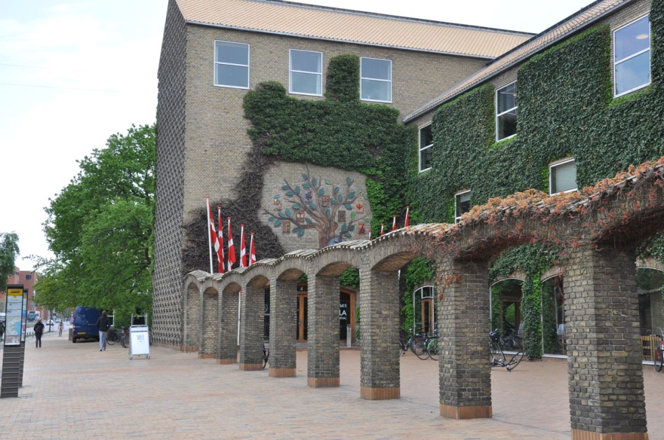
Main building University of Aarhus

Slide 13
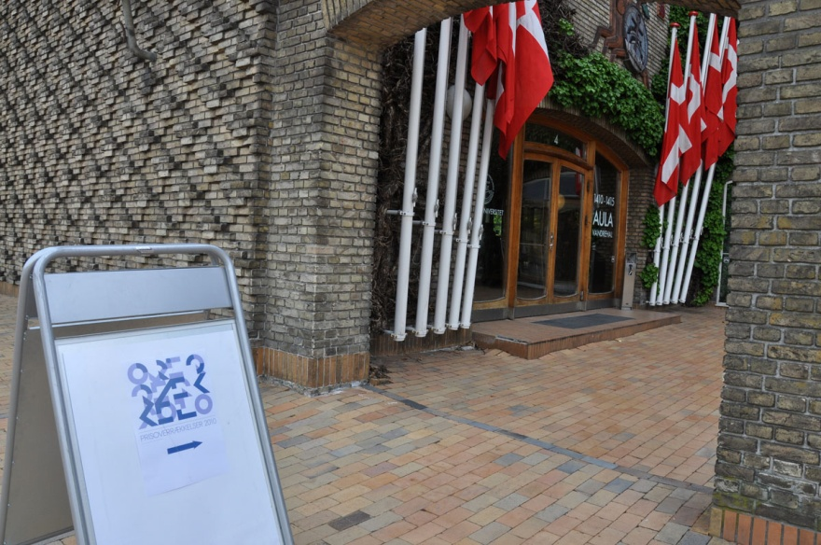
Danish flags for Bjarne

Slide 14
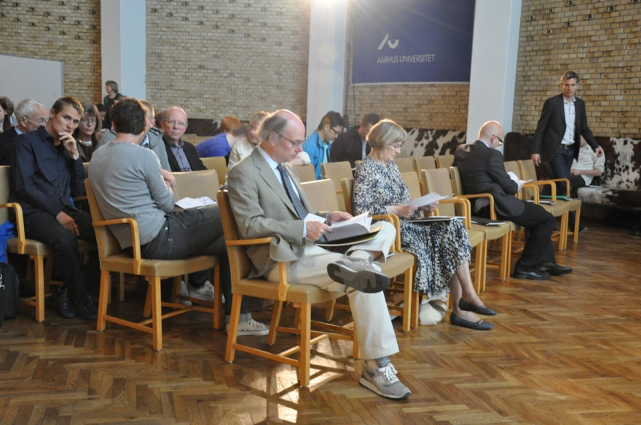
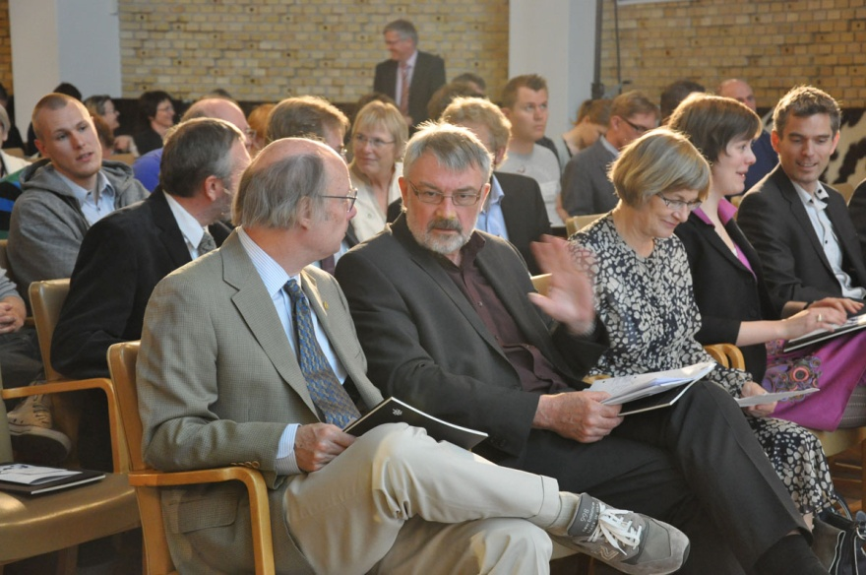
Before the prize-giving

Slide 15
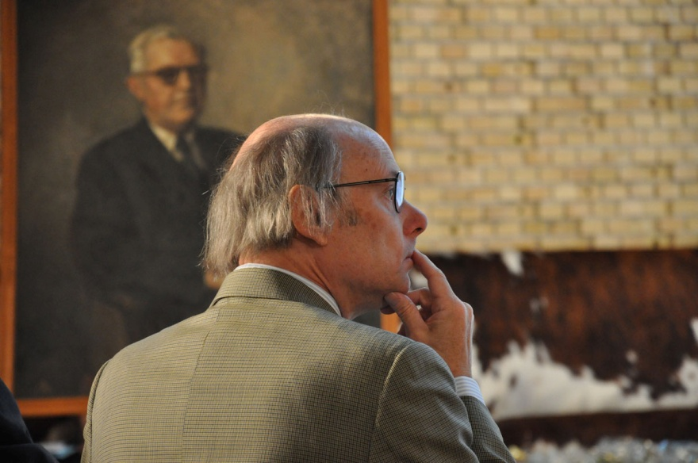

Slide 16
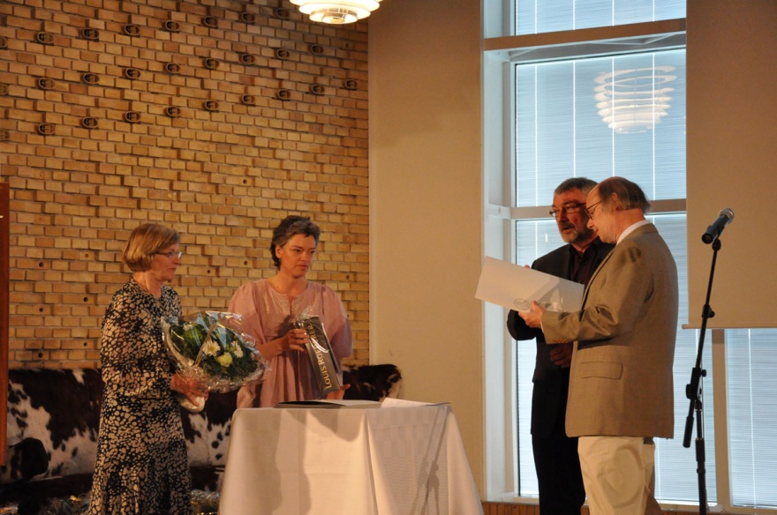

Slide 17
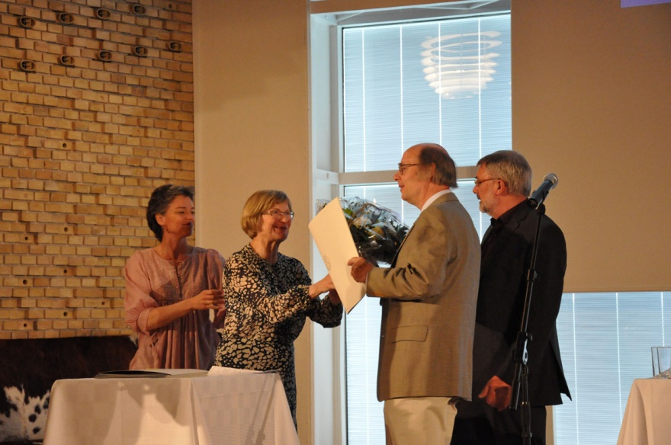

Slide 18
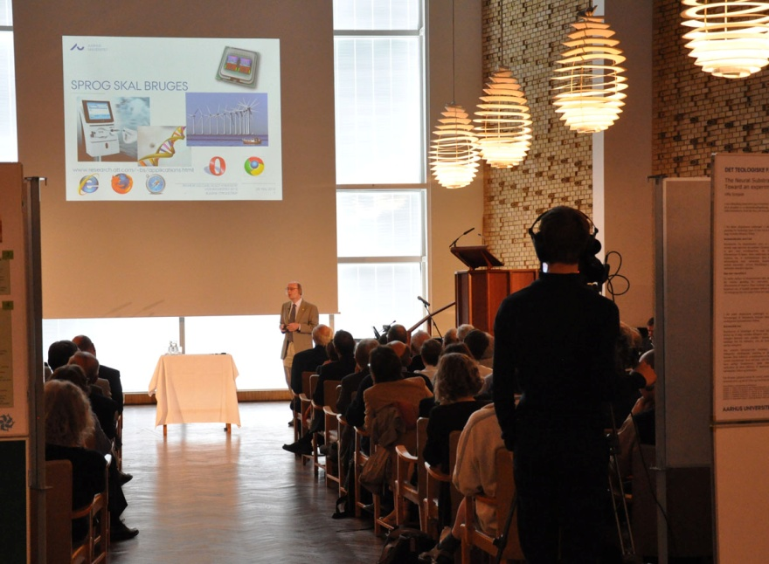
Bjarne’s talk

Slide 19
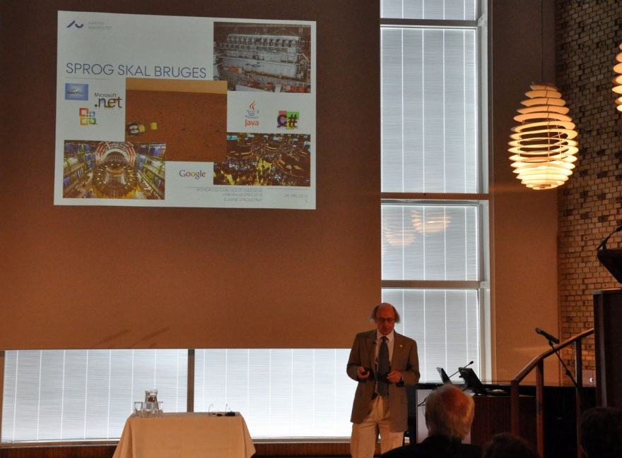

Slide 20
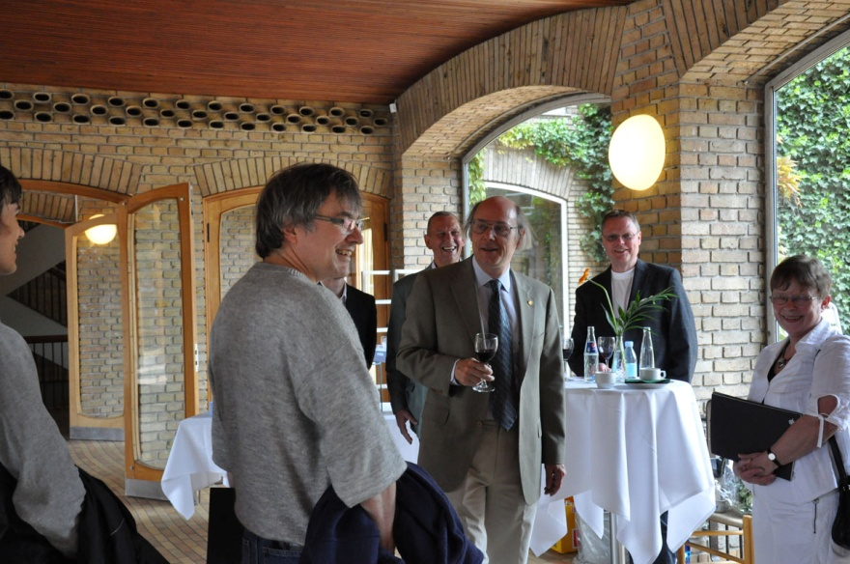
Reception after prize-giving

Slide 21
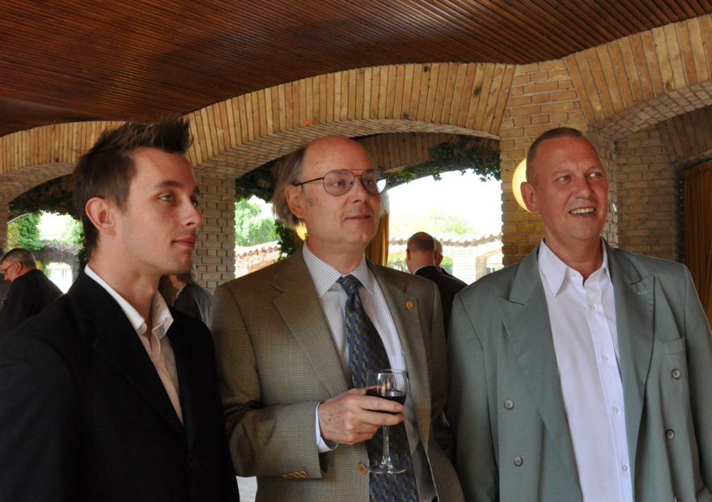
Bjarne between nephew and brother

Slide 22
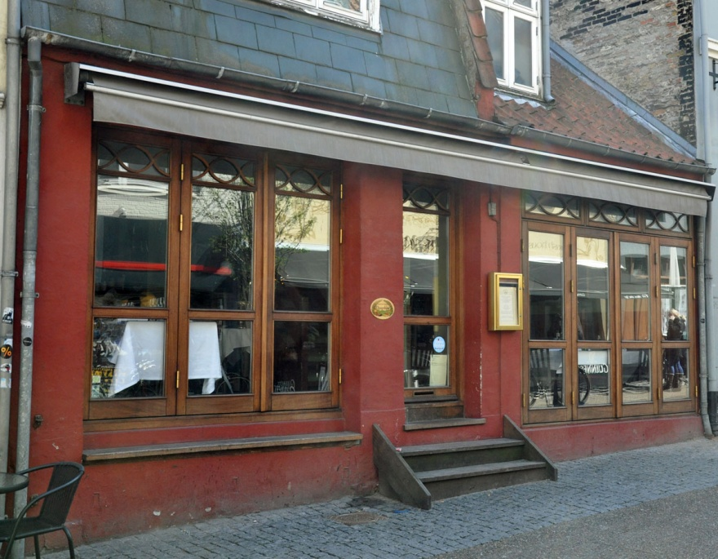
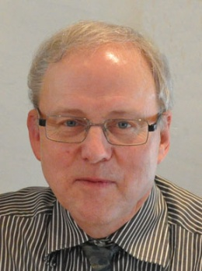
Restaurant Dauphine for evening dinner
Thank you Bjarne!
Excellent choice!

